Slide 1

Zen and the Art of
“borrowing”
other people’s work
MacAd UK – February 2016

Slide 2
DISCLAIMER
No people or animals were hurt during the events described within!
(but some VM’s were put to sleep)
This talk is not meant to be serious! Don’t Panic!

Slide 3
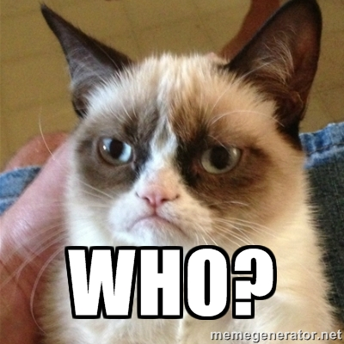
Who am I?
I am Richard Purves
(it’s pronounced “IS” not “ES”)
Slack / JAMFNation : franton
Twitter : @n0nsensefactory
WWW : www.richard-purves.com

Slide 4
Who am I?
In the end …
I’m just another mac admin ☺

Slide 5
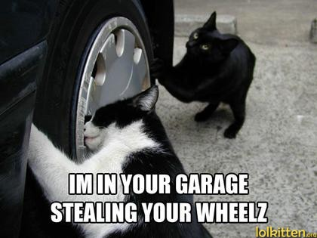
So what am I going to faff on about?
The Art of “Borrowing Work”

Slide 6

So what am I going to faff on about?
The Art of “Borrowing Work”
Stories of Woe

Slide 7
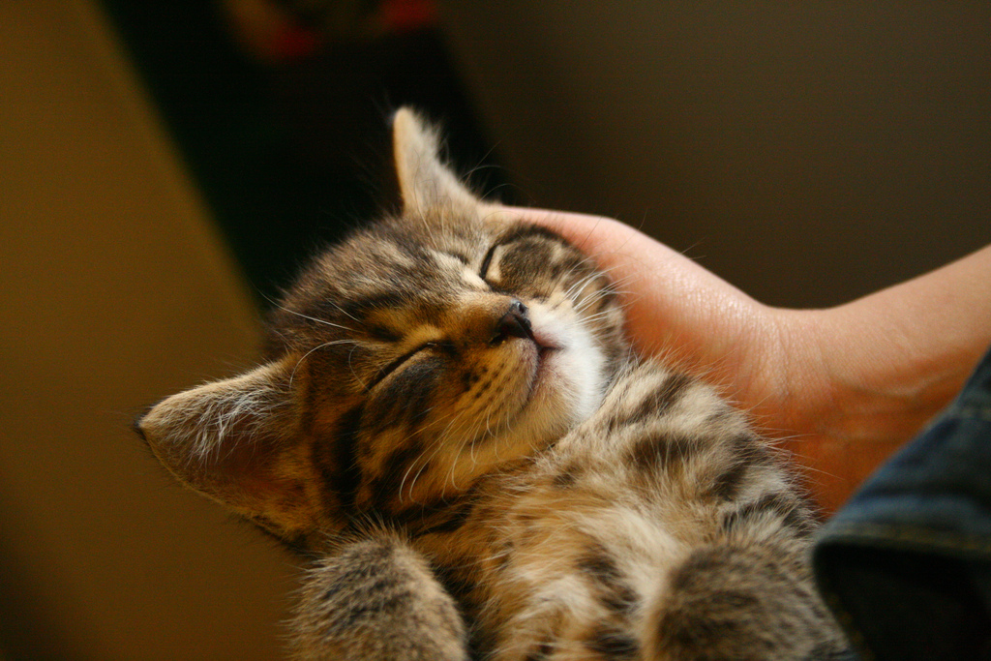
So what am I going to faff on about?
The Art of “Borrowing Work”
Stories of Woe
Stories of Triumph

Slide 8

So what am I going to faff on about?
The Art of “Borrowing Work”
Stories of Woe
Stories of Triumph
Lessons learned!
Notes:
No cat pictures here as “lessons learned kitty” gets you images of something else entirely. Don’t image search that!
All aboard the FAIL Boat!

Slide 9

So what am I going to faff on about?
The Art of “Borrowing”
Stories of Woe
Stories of Triumph
Lessons learned!
Wholly Gratuitous Plugs
???

Slide 10

Zen and the Art of Borrowing
WHY IN ALL THAT IS HOLY WOULD YOU WANT TO ACTIVELY RIP OFF OTHER PEOPLE?????

Slide 11
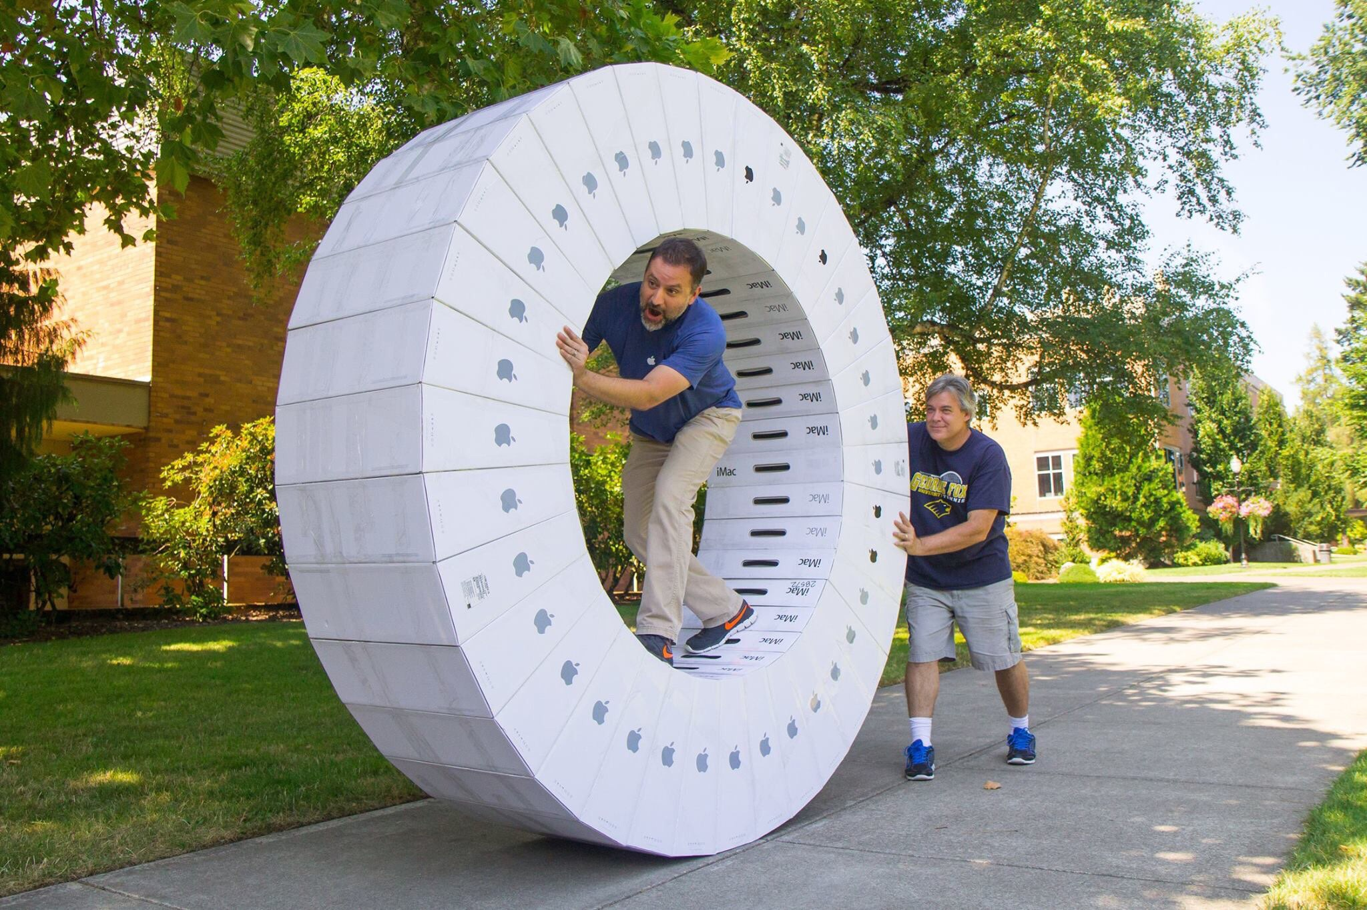
Zen and the Art of Borrowing
Saving time by not re-inventing the wheel.

Slide 12

Zen and the Art of Borrowing
Saving time by not re-inventing the wheel.
Be your own “Scotty”.

Slide 13
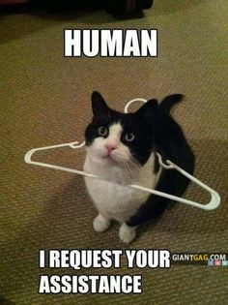
Zen and the Art of Borrowing
Saving time by not re-inventing the wheel.
Be your own “Scotty”.
Can you learn new tricks from it? / Can you help the wider OS X Community?
It’s all about
“Paying It Forward”
(even though I hate that film!)

Slide 14
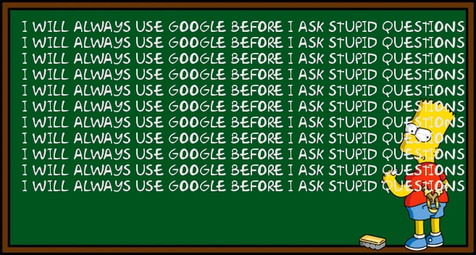
Zen and the Art of Borrowing
OK you sold me. How do I start?
Google is your friend

Slide 15

Zen and the Art of Borrowing
OK you sold me. How do I start?
Google is your friend
GitHub search is your best friend ;)

Slide 16
Zen and the Art of Borrowing
OK you sold me. How do I start?
Google is your friend
GitHub search is your best friend ;)
Technical Blogs

Slide 17
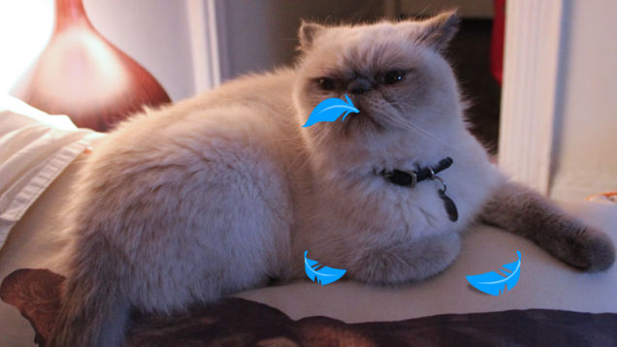
Zen and the Art of Borrowing
OK you sold me. How do I start?
Google is your friend
GitHub search is your best friend ;)
Technical Blogs
Twitter!
Notes:
Given that twitter has got rid of a chunk of employees, this pic might be more true than planned.

Slide 18
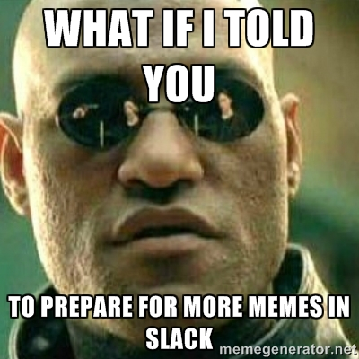
Zen and the Art of Borrowing
OK you sold me. How do I start?
Google is your friend
GitHub search is your best friend ;)
Blogs. Lots of Blogs.
Twitter!
IRC
5. Slack MacAdmin

Slide 19

Stories of Woe
Implementing FileVault 2 via Munki
As part of the automation work for one client, automatic FV2 enabling for all clients was requested.
“fdesetup” can be passed an xml file to automate the process
I was generating the xml from a post-install script in Munki
Post-install scripts are cached on the client in CLEAR TEXT and are user visible.
Gulp.
Notes:
Borrowed on all the FV2 work done by Rich Trouton.

Slide 20
Stories of Woe
Implementing FileVault 2 via Munki
Solution: Stopped using it pending rethink.
I had to leave it to my replacement as I was due to go to Saudi Arabia the following week!
This is both how to “borrow” and how not to “borrow”.
Notes:
Successfully made use of information shared out there. Totally failed in other ways.

Slide 21
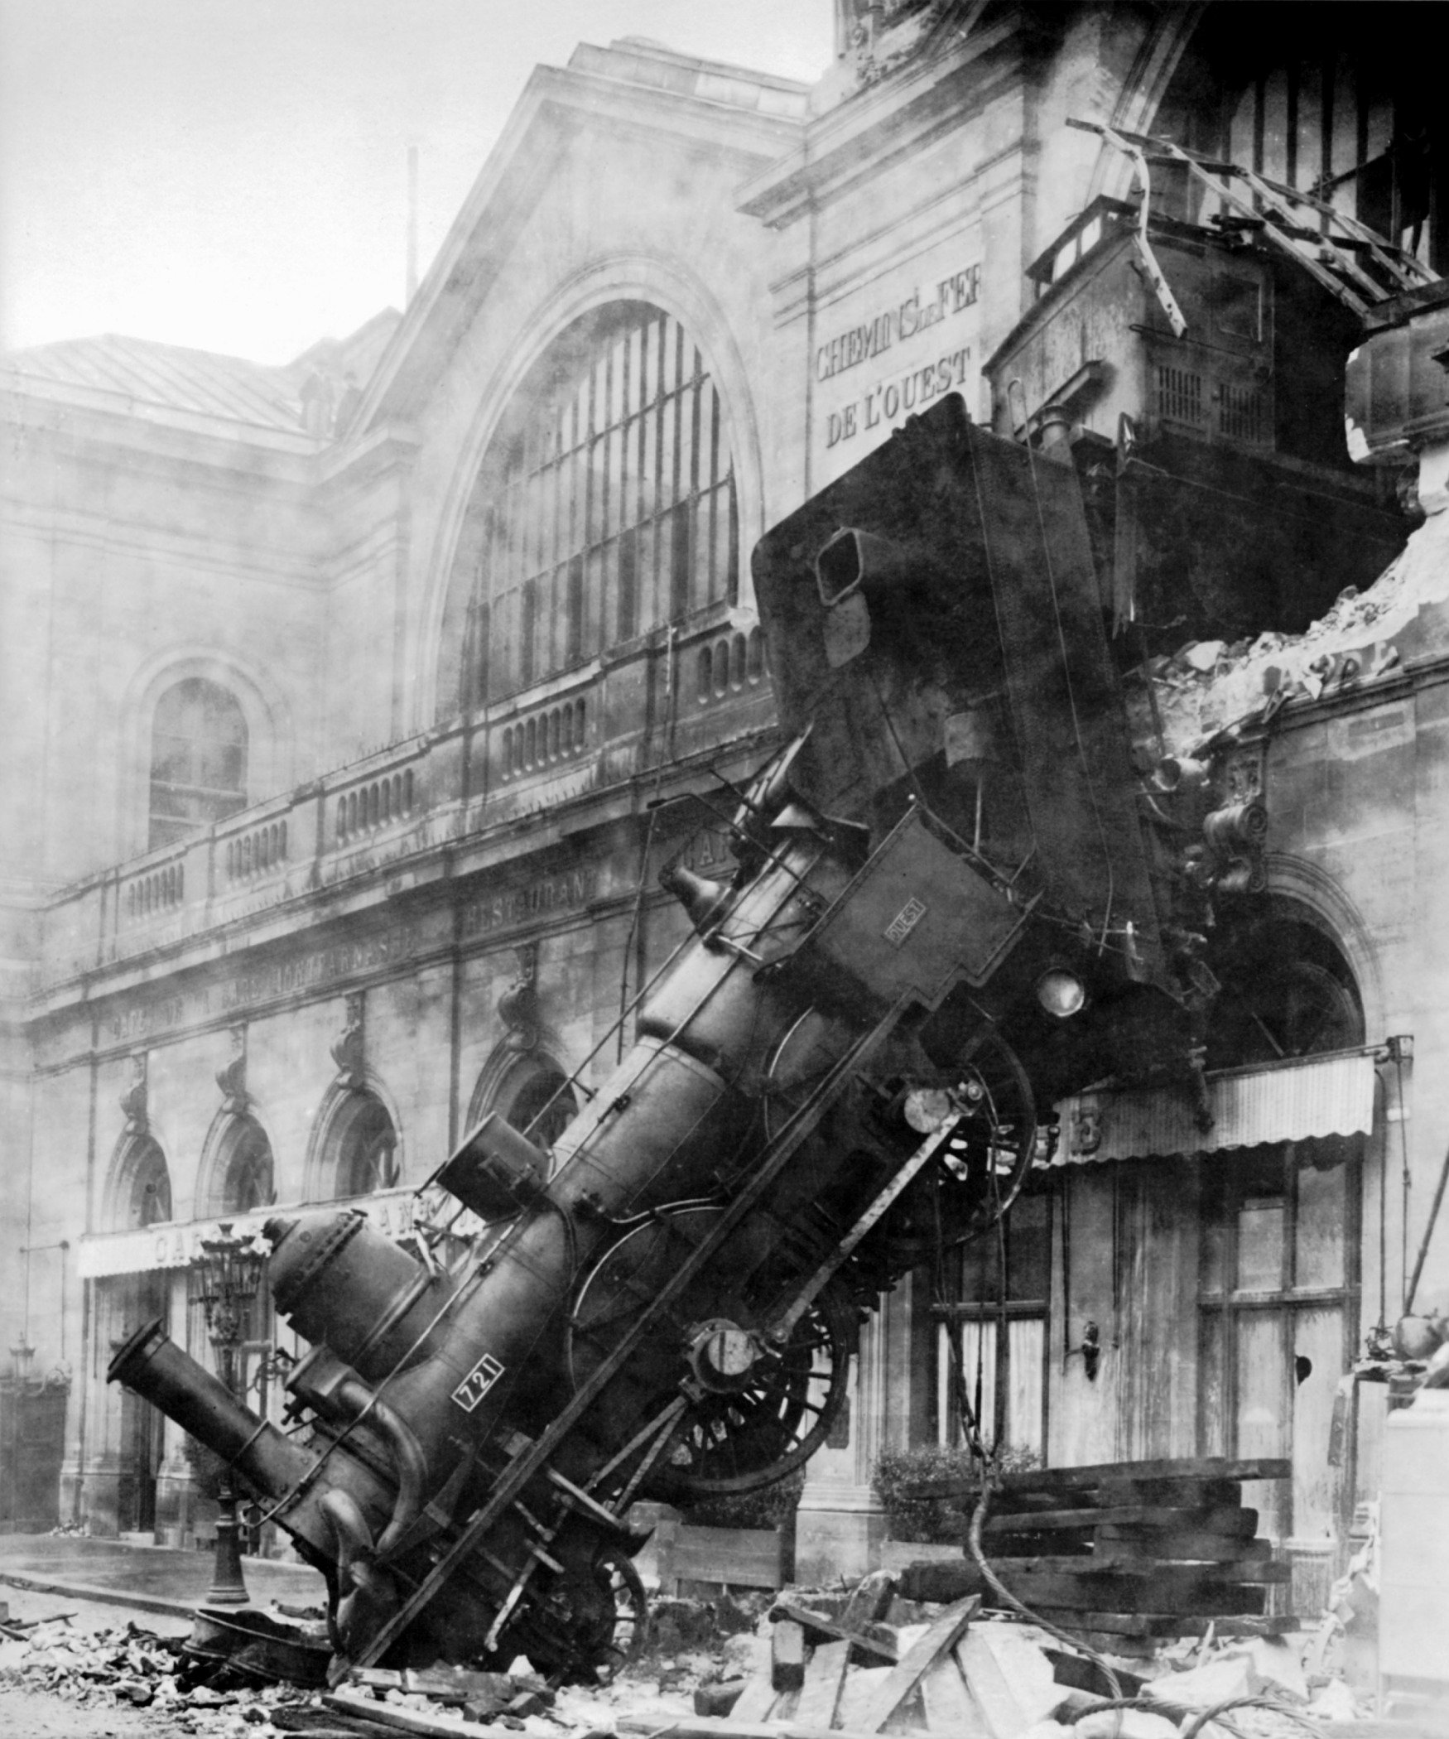
Stories of Woe
2. Testing JAMF’s NetSUS
I was planning the strategy to replace many 8yr old Xserve’s
NetSUS (at the time) was the only non Apple solution.
Implemented and ran a P.o.C on a single user subnet. Seemed ok.
Imaging then slowly broke across the entire organisation.
Notes:
While NetBoot protocol information is out there, writing your own should be left to people like Pepjin!

Slide 22
Stories of Woe
2. Testing JAMF’s NetSUS
Solution: We pulled the plug on NetSUS.
Once it was dead, problems went away. It was only later from Duncan McCracken’s talk at MacSysAdmin 2014 did I find out what had gone wrong.
Recommendation: Use BSDPy or Server.app instead ;)

Slide 23
Stories of Woe
2. Testing JAMF’s NetSUS
NetSUS imaging priority is hard wired to MAXIMUM.
It was usurping every subnet it was set to “listen” to.

Slide 24
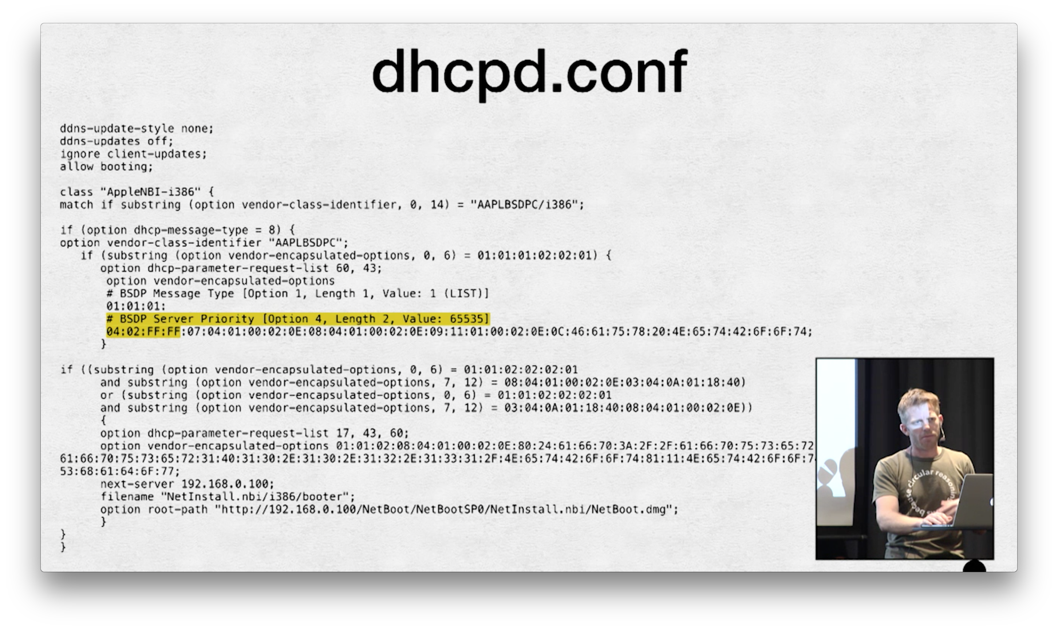
Notes:
Screen grab from MacSysAdmin 2014 … Duncan McCracken’s netboot talk.
Great example of someone else’s work providing that eureka moment.

Slide 25

Stories of Triumph
Automating Mac Server.app Builds
I’ve a script that automates the Server.app config process.
Server.app until v5.03 licence acceptance was by GUI only.
Rich Trouton had a word with an Apple Engineer at WWDC 2015.
Notes:
This one’s a more blatant “borrow”. Others had been frustrated by this one.

Slide 26
Stories of Triumph
Automating Mac Server.app Builds
Rich Trouton/Charles Edge got a CLI based licence acceptance put into Server.app 5
And blogged about it.
And I then had an “A-HA!” moment.
Followed by a “DAMNIT! He beat me to it!”
Again!
If you can’t beat ‘em, “borrow”!
Notes:
Posted on jamfnation. Apparently became JAMF’s official “fix” for the problem.

Slide 27
Stories of Triumph
Automating Mac Server.app Builds
As a result, Rich & Charles get full credit for solving that issue and within my script too.
One less thing to worry about with it, but essentially …

Slide 28
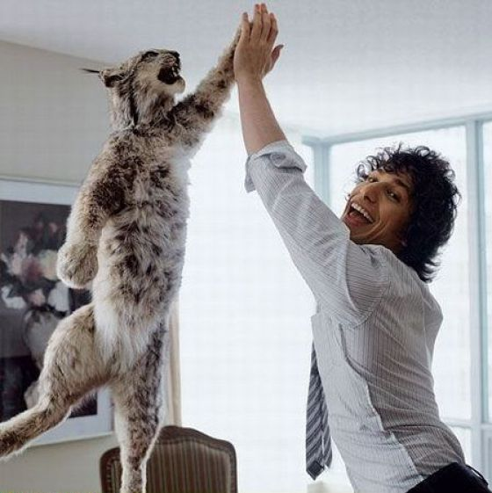
Stories of Triumph
Automating Mac Server.app Builds
SUCCESS!

Slide 29
Stories of Triumph
2. Contributing to Lachlan Stewart’s Patchoo project.
Lachlan forked CocoaDialog so it runs over the loginwindow and on logout.
Patchoo Deploy contains some horrible AppleScript code for menu dialogs.
Patchoo was accessing the JSS API using the MAC address as the computer identifier.
Notes:
Good artists steal. Great artists steal and make better.

Slide 30
Stories of Triumph
2. Contributing to Lachlan Stewart’s Patchoo project.
I got a wonderfully nice note of appreciation for my trouble too …

Slide 31
Stories of Triumph
2. Contributing to Lachlan Stewart’s Patchoo project.
Notes:
Think the answer is “very well” ☺

Slide 32
Lessons Learned
I ran out of Zen and Cat pictures at this point!

Slide 33
Lessons Learned
Don’t blindly use things and expect them to work first time!
Investigate why before asking for help
British Army 6 P’s …
Plan how you’re going to revert if it all goes wrong!
Notes:
Proper Planning Prevents Piss-Poor Performance

Slide 34
Lessons Learned
Collect and give appropriate feedback where possible
Be prepared to be the very first to face that issue!
Share what you find with the community
Avoid NDA’s in employment contracts
Good Karma is always a plus!

Slide 35
Wholly Gratuitous Blatant Plugs
Rich Trouton : http://derflounder.wordpress.com/
Ben Toms : http://www.macmule.com/
Greg Neagle : https://managingosx.wordpress.com/
Charles Edge : http://krypted.com/
http://krypted.com/guides/macadmin-links/
JAMF Nation : http://jamfnation.jamfsoftware.com/
Slack : https://macadmins.herokuapp.com/
Me! : http://www.richard-purves.com/

Slide 36

One More Thing …
(“borrowing” only makes sense if you let people “lend” in the first place)
Notes:
In a spirit of “I’ve borrowed, so I’m now lending …”

Slide 37
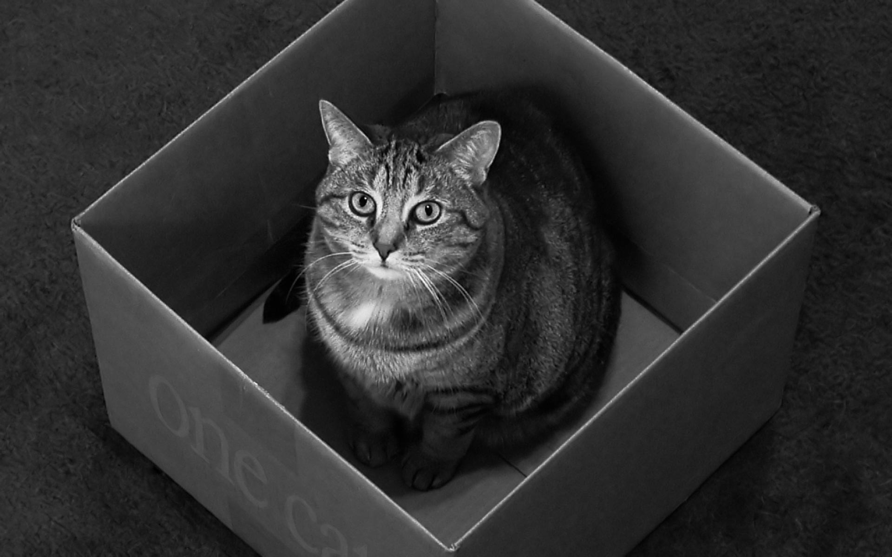
Introducing …
JSS-In-A-Box

Slide 38
Introducing …
JSS-In-A-Box
One stop Ubuntu based setup script for JAMF’s JSS
Takes care of server software installation
Installs a JSS from a single ROOT.war
Internal / External MySQL database connectivity
Single or Multi-Instance creation and deletion
Database backup and restoration
JSS upgrading (or even downgrading with db limits)
Server Hardening (Firewall / HTTPS on 443 through LetsEncrypt)
Ubuntu 14.04 LTS server only at present.

Slide 39
Introducing …
JSS-In-A-Box
Available Today
(for free)
http://www.richard-purves.com/?p=136
http://www.github.com/franton/JSS-In-A-Box

Slide 40
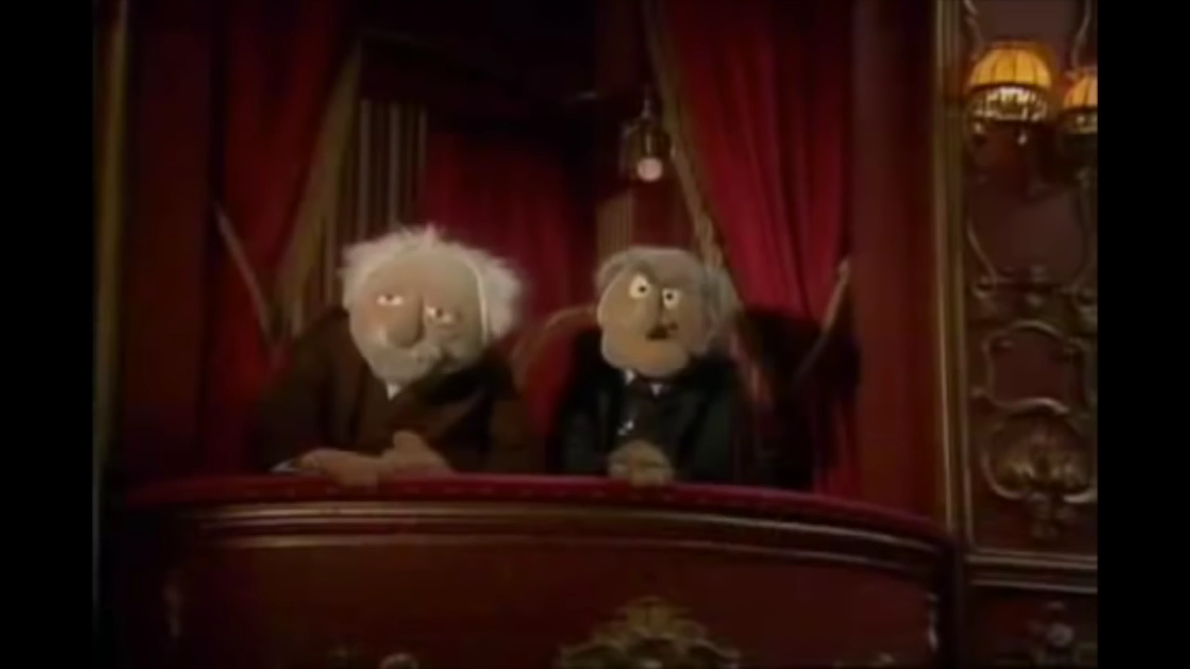
And Now some words from my sponsor …

Slide 41

Any
Questions?
Zen Master = Jedi Master right? ☺

